Slide 1
How to Read/Summarize/Write a Research Paper
CSE 300: Technical Writing & Presentation

Slide 2

How to
Read
Write
Present
Review
Summarize
How to ___ a Research Paper?

Slide 3
Section 1: READ

Slide 4
How to ___ a Research Paper?
Read
Summa-rize
Read
Review

Slide 5


Slide 6




Review
Conference
Journal
Class
Keep Up-to-date
Own
Field
Literature review
New
Field

Slide 7




Topic
Right paper?
Exp. vs. Theor.?
Venue
Reputed venue?
Jour. vs. Conf.?
Quality
Citation?
Impact?
Authors
Reputed?
Recent Works?

Slide 8


Slide 9



Slide 10

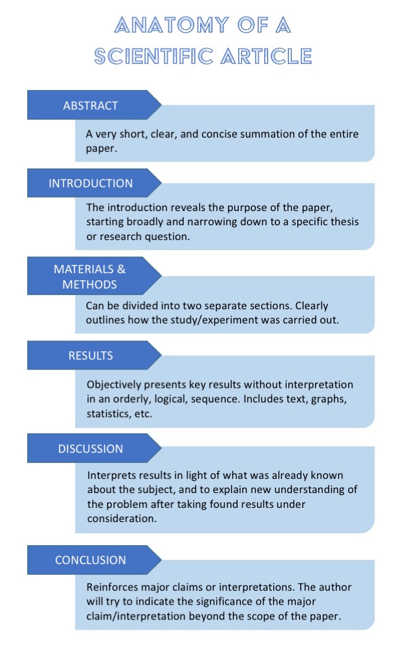
IMRaD

Slide 11


Slide 12
Multi-Pass Approach

Slide 13

General Idea
Pass 1
Content
(No Details)
Pass 2
Depth
Pass 3
Multi-Pass Approach

Slide 14



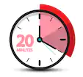
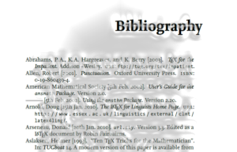

Pass 1
Headings
Sub-heading

Slide 15


3Cs
Context
Clarity
Contributions
Pass 1
Correct
(Assumptions)
Category

Slide 16
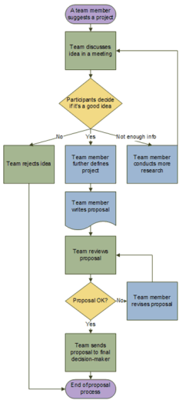
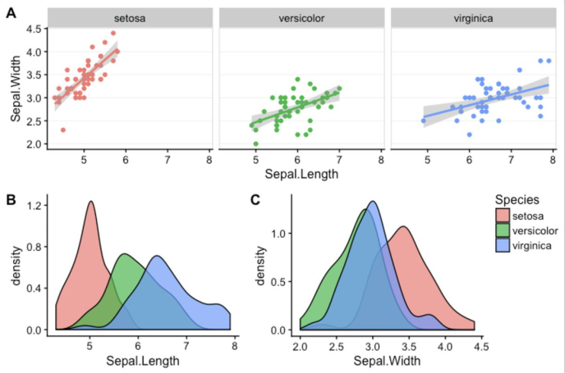




Pass 2

Slide 17
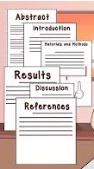


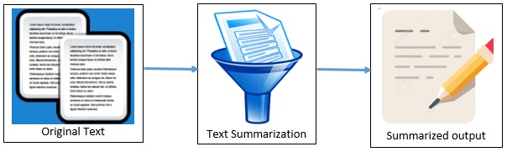
Pass 2

Slide 18


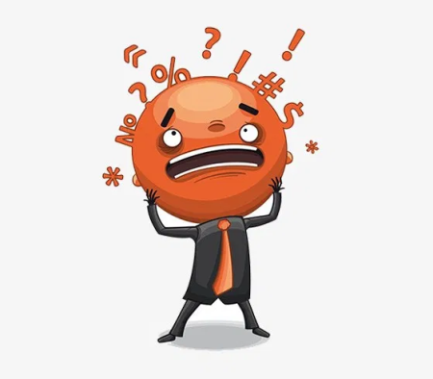
Set the paper aside
Return to the paper later
Reading background material
Persevere and go to next pass
Pass 2
New
Poor
Jargons
Forward ref.
Not Understandable

Slide 19

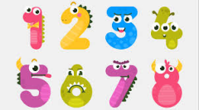
Pass 3
Make author assumptions
Re-create the work
Identify failings and assumptions
Insight
Pinpoint issues
Literature Survey

Slide 20



Pass 3
Google Scholar
3-5 Papers
Check Related Works Section
Pointer to a Survey paper
Read the Survey
Literature Survey

Slide 21

Pass 3
Literature Survey
Key Persons
Check citations
Find web pages
Top venues
Where the key persons publish
Conferences
Proceedings/
Archives
Download papers
Read
Journals
Multi-pass
Repeated Authors

Slide 22

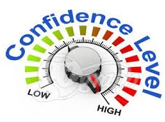
Pass 3
Reconstruct the entire structure of the paper from memory.
Identify its strong and weak points.
pinpoint implicit assumptions, missing citations.
Identify potential issues with experimental or analytical techniques.

Slide 23

Read Critically
Read Creatively
Take Notes

Slide 24

Read Critically
New Knowledge
Appropriate Design
Biasness
Right Protocol
Justification
Relevance

Slide 25
Read Creatively
Any Good Ideas?
Idea Extensions?
Influential results?
Possible Improvements?

Slide 26
Take Notes
Your will Forget
Electronic Notes
Written Notes

Slide 27

Summarization

Slide 28


Summarization

Slide 29

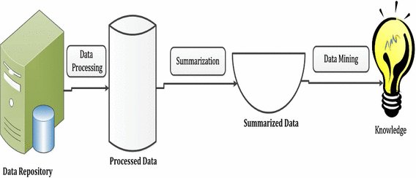
Automatic Summarization

Slide 30
Section 2: WRITE

Slide 31
How to write a Research Paper?

Slide 32


Slide 33


Putting too much in one paper makes it diffuse and less compelling
A single question clearly stated with adequate evidence for the answer.
Try stating the question and its answer in one simple sentence.
What do I have to say in the paper?
Is it one or more papers?
Salami Science???

Slide 34

Wastes Journal space
Time waste for Reviewers
Time waste for Readers
Reporting the results of a single study in 2 or more manuscripts.
Salami Science
Publish or Perish
Quantity; Not Quality
More Support
When Justified?
Different audience targets
Too long a manuscript
3 Reasons
Notes:
The panelists offered 3 possible reasons. First, many authors, especially in the academic world, face the pressure to publish or perish. If researchers supported by colleges and universities do not publish, they can lose their standing, their potential tenure, and possibly even their jobs. In response to the pressure, some researchers publish more than one paper per study.
Second, researchers need to fund their projects by applying for grants. All too often grant reviewers judge the potential success of applicants by the numbers of their publications, not necessarily by the merits of the publications or the grant proposals. To increase their appeal to grant reviewers, authors might inflate the numbers of publications they have to their credit. Third, to obtain a patent or to protect the financial interests of an existing drug about to lose its patent, pharmaceutical companies might have a financial incentive to show that a drug has more support in the literature than it actually has. Publishing papers, each citing different parts of the same study, can inflate the amount of data from that study, making it seem as though there is more support than there really is.
Occasionally splitting a study into several papers might be justified. The panelists suggested that salami science be studied by editors and reviewers case by case, and they offered 2 possible scenarios. One commonly cited justification of salami science is the needs of different audiences. For example, part of a study might be valuable to one audience—say, experimenters—and another part might appeal more to a different audience—say, clinicians. If the paper were not sliced up and published twice, one or the other group of readers might miss valuable data. Another possible justification is that a manuscript is too large to publish as a single paper. For example, a journal has limited resources and cannot publish the paper in its entirety, or the study would be more digestible if reported in 2 or more papers.

Slide 35

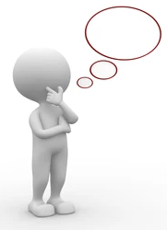
Is the paper worth writing?
What is in the literature?
It is a lot of work!!!
20-30 drafts!!!
Don’t do this unless it is worth.

Slide 36
OK, So you want to/need to write a paper…
So, How to Proceed?

Slide 37
More Questions
FAV
Format
Audience
Venue
Article
Original Research
Letter
Short
Comm.
Review
Like a focused mini book
All Related to each other
Journal
Conference
Which J/C
Who cares?
Notes:
What is the right format for the message (original article/review?)
What is the right audience—who cares?
What journal (i.e., venue) should I choose?

Slide 38

Venue Scope?
Allowed Format?
Audience Match?
Impact?
Take advice
Mentor
Consequence of Wrong Decision
time lost
senior researchers
failure to publish

Slide 39

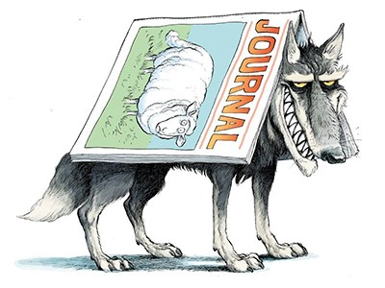
Choice
Parameters
Impact Factor
SCImago Rank
Editorial Board
Publisher
Indexing
…
https://beallslist.net/

Slide 40
Research article as a critical Argument
Research Article
Problem Statement posing a question
Presentation of evidence
Assessment of the validity of the evidence in the face of ..
strengths/weaknesses
other evidence
Conclusions

Slide 41
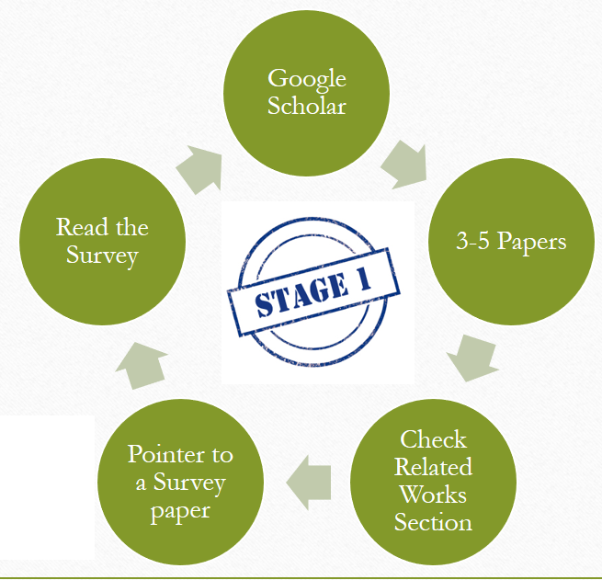
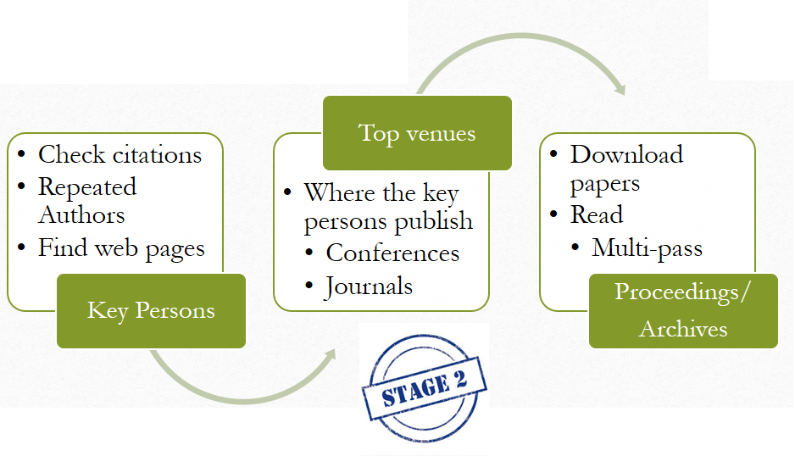
Literature Survey
Recall…

Slide 42
Literature Survey
High Sens.
Low False -ve
Misses only a few
What has been done and what can you say that’s new?
Be thorough in your search:---a high sensitivity/low specificity search.
Low Spec.
High False +ve
Too eager to find +ve
Notes:
What does it mean to have a low specificity?
A test with low specificity can be thought of as being too eager to find a positive result, even when it is not present, and may give a high number of false positives. This could result in a test saying that a healthy person has a disease, even when it is not actually present.
A highly sensitive test means that there are few false negative results, and thus fewer cases of disease are missed.

Slide 43
Title Page
Fix earlier than later
Title
Tentative
Author Order
Avoid hurt feeling
Assign Responsibilities
Sources
of
Support
Acknowledgement
Order
Alphabetic
Corr.
Senior
First
Notes:
There are various traditions regarding author order

Slide 44
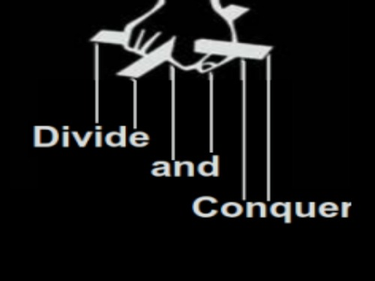

Create an outline first
Plan on multiple drafts
Filename with dates
One filename written over with new draft
Tables/figures early
Deadlines for you and coauthors
prompt more analysis
Notes:
Divide and conquer. Rather than trying to write your entire document, choose some specific part, and write just that part. Then, move on to another part

Slide 46

Introduction
Draw audience in; be provocative
Target journal specific audience
Identify gaps in knowledge
End with question/hypothesis
5Qs
(CS)
What is the problem
Why is it interesting and important?
Why is it hard? (E.g., why do naive approaches fail?)
Why hasn't it been solved before? (Or, what's wrong with previous proposed solutions? How does mine differ?)
What are the key components of my approach and results?

Slide 47
Methods
Should include subheadings
Should be comprehensible by nontechnical reader
Past tense
Should be replicable
Write clearly enough

Slide 48


Results
Organize around tables/figures
Past tense
No interpretation; just the facts!
Tables/Figures should be self-contained
Fig. vs. Tab.
Mix-up
Suppl.

Slide 49
Discussions
1st part
Answer main question/ hypothesis
2nd, 3^{rd, …}
Evidence pros & cons
Last part
Concluding remarks
Future directions
Implications of findings (be conservative)
Other findings of your study
Limitations of your study
Interpret the main results
Can take help from the Results section content
Could constitute a separate section

Slide 50

Writing Tips
Tense
When quoting previously published work, refer to it in present tense.
When describing your own study, refer to work in past tense
Methods and Results in Past tense

Slide 51
Writing Tips
Voice
Some branches dictate passive voice only
Some allow (sometimes prefer) active voice
Best practice: Mixed voice

Slide 52
Writing Tips
Brevity
Be brief. Make every word count.
If a word does not support your point, cut it out.
Use shorter and more direct phrases wherever possible.

Slide 53
Writing Tips
Section
Paragraph
Sentence
Word
Ask what role it serves
Whether it contributes to the paper's main point
If not, delete it
For each section
in the paper

Slide 54
Writing Tips
Section
Paragraph
Sentence
Word
Does it have a single point
Whether it contributes to the goal of the section.
If not, rewrite or delete it.
For each paragraph
in a section

Slide 55
Writing Tips
Section
Paragraph
Sentence
Word
Does it have a single point
Whether it strengthens the para
If not, rewrite or delete it
For each sentence
in a para

Slide 56
Writing Tips
Section
Paragraph
Sentence
Word
Whether it strengthens the point
If not, rewrite or delete it
For each word in a sentence

Slide 57
Proofread
Are terms used consistently throughout?
Do numbers in abstract match numbers in text and tables?
Do citations in text match references?
Are Syntax and Grammar acceptable

Slide 58
Abstract
Mini-paper
Introduction (usually 1-2 sentences)
Methods (often longest part)
Results (no tables/figures)
Discussion is limited to concluding statement
Like a paper
requires many drafts
most oriented to presenting argument concisely

Slide 59


